Slide 1
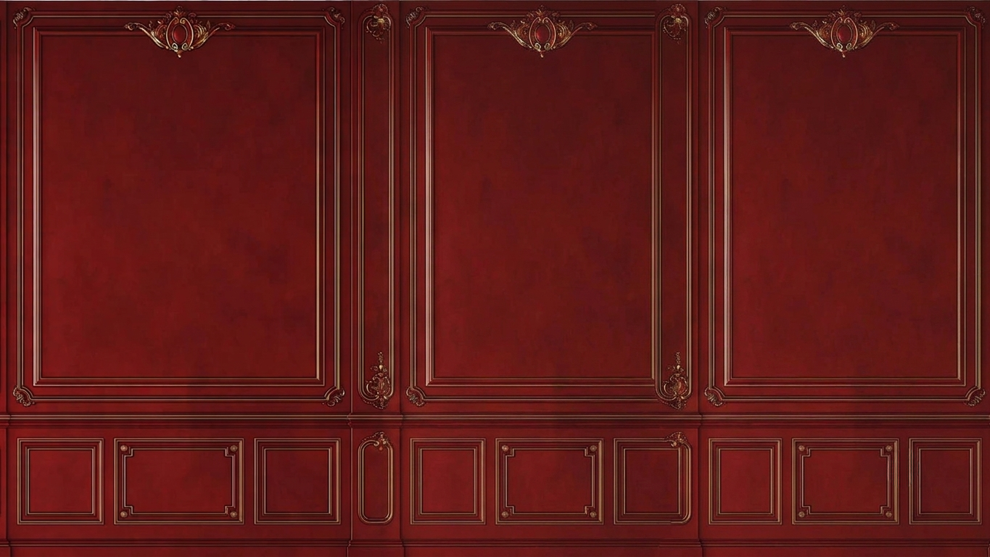


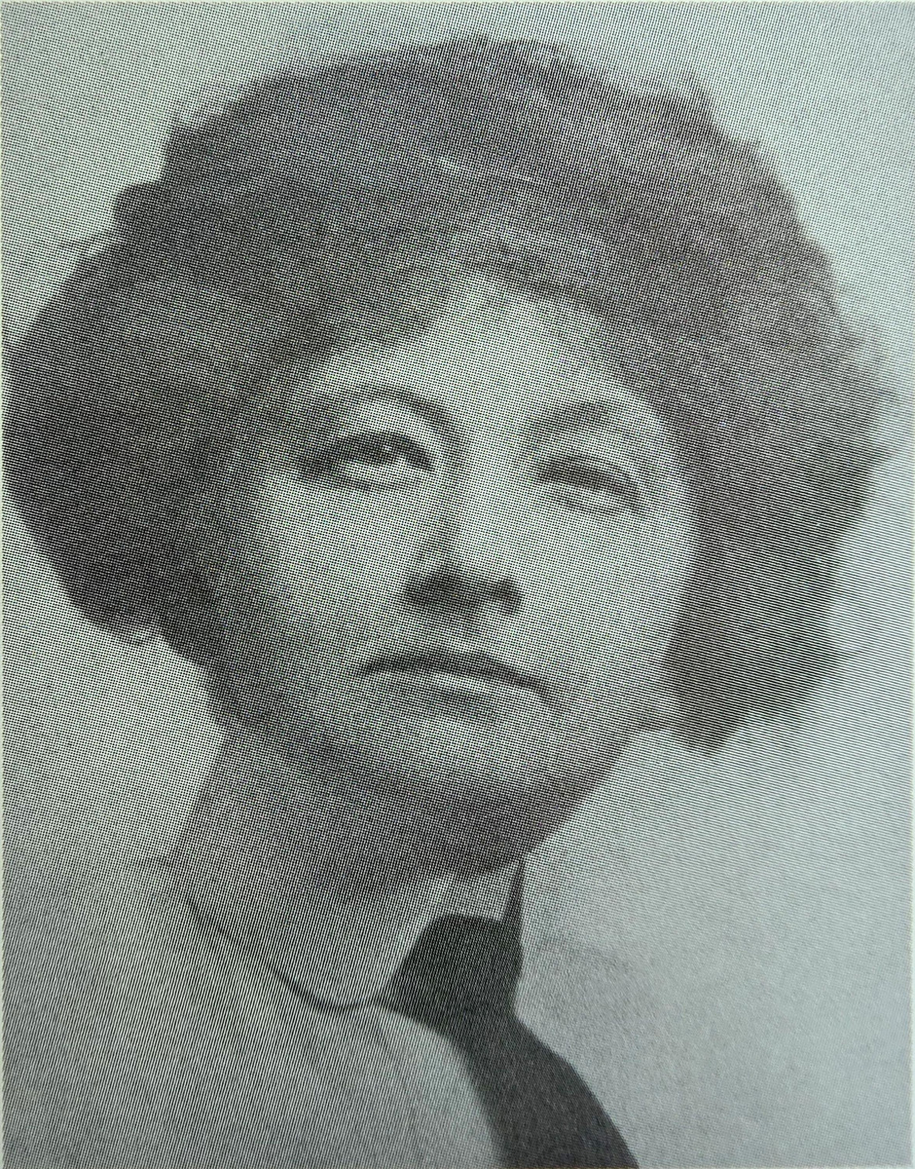
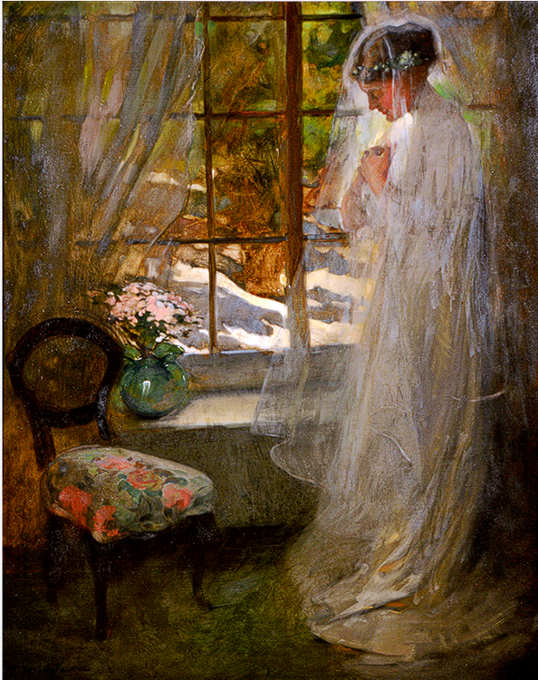


The Threshold
Florence Carlyle
( 1912 )
Oil on canvas, 117.0 x 96.5 cm
Inscription recto: 1:1, F Carlyle
Collection: The Ontario Collection, Government of Ontario, Toronto
( 1964 - 1923 )
Florence Carlyle (1864–1923) was born in Galt, Ontario, but moved to Woodstock, Ontario, when she was just seven years old. Carlyle travelled to Paris in 1890 and spent the next six years studying painting, becoming accomplished enough to have paintings exhibited at the 1893 and 1894 Paris Salons. Although she briefly established a studio in London, she returned to Canada just before her 32nd birthday. In 1913 Carlyle moved to England, eventually settling in Crowborough, where she lived in Sweet Hawes cottage with Juliet Hastings. Carlyle continued to paint and exhibit, but both her volunteer work during World War I and her gradually failing eyesight significantly reduced her artistic production. After the war, Carlyle began to write. Her story Mary’s Child was published in a British newspaper in November 1923. Unfortunately, Carlyle never had the chance to see her work in print; she passed away on May 2, 1923, at the age of 58.

Slide 2
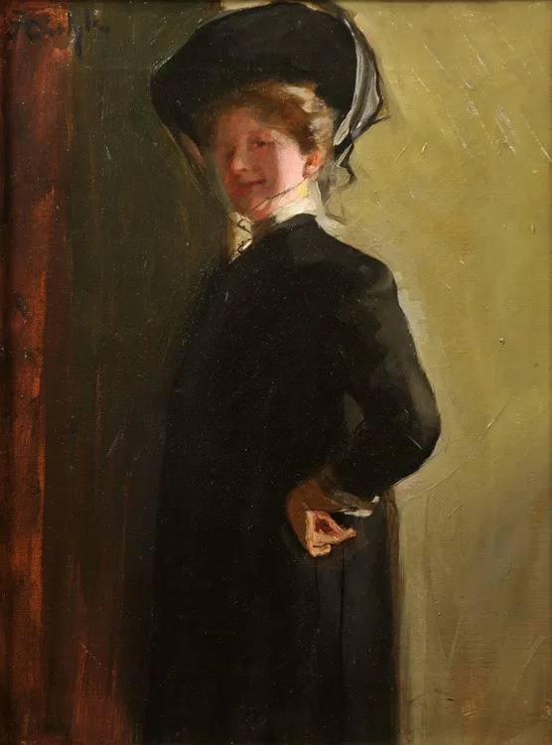
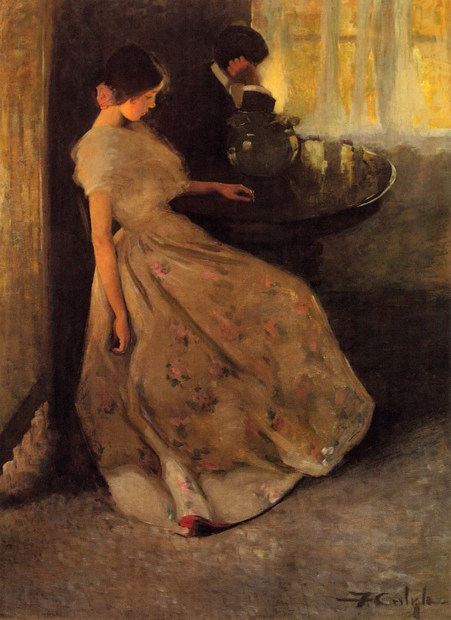
The Threshold
Florence Carlyle
( 1912 )
Self Portrait
( 1964 - 1923 )
Oil on canvas, 117.0 x 96.5 cm
Inscription recto: 1:1, F Carlyle
Collection: The Ontario Collection, Government of Ontario, Toronto
( 1901 )
Florence Carlyle (1864–1923) was born in Galt, Ontario, but moved to Woodstock, Ontario, when she was just seven years old. Carlyle travelled to Paris in 1890 and spent the next six years studying painting, becoming accomplished enough to have paintings exhibited at the 1893 and 1894 Paris Salons. Although she briefly established a studio in London, she returned to Canada just before her 32nd birthday. In 1913 Carlyle moved to England, eventually settling in Crowborough, where she lived in Sweet Hawes cottage with Juliet Hastings. Carlyle continued to paint and exhibit, but both her volunteer work during World War I and her gradually failing eyesight significantly reduced her artistic production. After the war, Carlyle began to write. Her story Mary’s Child was published in a British newspaper in November 1923. Unfortunately, Carlyle never had the chance to see her work in print; she passed away on May 2, 1923, at the age of 58.
Oil on canvas, 62.0 x 52.0 cm
Inscription recto: u.l., F Carlyle
Collection: The Woodstock Art Gallery

Slide 3
Florence Carlyle
The Threshold
The Tiff
Florence Carlyle (1864–1923) was born in Galt, Ontario, but moved to Woodstock, Ontario, when she was just seven years old. Carlyle travelled to Paris in 1890 and spent the next six years studying painting, becoming accomplished enough to have paintings exhibited at the 1893 and 1894 Paris Salons. Although she briefly established a studio in London, she returned to Canada just before her 32nd birthday. In 1913 Carlyle moved to England, eventually settling in Crowborough, where she lived in Sweet Hawes cottage with Juliet Hastings. Carlyle continued to paint and exhibit, but both her volunteer work during World War I and her gradually failing eyesight significantly reduced her artistic production. After the war, Carlyle began to write. Her story Mary’s Child was published in a British newspaper in November 1923. Unfortunately, Carlyle never had the chance to see her work in print; she passed away on May 2, 1923, at the age of 58.
( 1912 )
Self Portrait
( 1902 )
Oil on canvas, 117.0 x 96.5 cm
Inscription recto: 1:1, F Carlyle
Collection: The Ontario Collection, Government of Ontario, Toronto
( 1901 )
Oil on canvas, 183.8 x134.6 cm
Collection: Art Gallery of Ontario, Toronto (72/14)
Oil on canvas, 62.0 x 52.0 cm
Inscription recto: u.l., F Carlyle
Collection: The Woodstock Art Gallery

Slide 4
The Threshold
( 1912 )
Self Portrait
Oil on canvas, 117.0 x 96.5 cm
Inscription recto: 1:1, F Carlyle
Collection: The Ontario Collection, Government of Ontario, Toronto
Oil on canvas, 62.0 x 52.0 cm
Inscription recto: u.l., F Carlyle
Collection: The Woodstock Art Gallery

Slide 5
The Threshold
( 1912 )
Self Portrait
Oil on canvas, 117.0 x 96.5 cm
Inscription recto: 1:1, F Carlyle
Collection: The Ontario Collection, Government of Ontario, Toronto
( 1901 )
Oil on canvas, 183.8 x134.6 cm
Collection: Art Gallery of Ontario, Toronto (72/14)
Oil on canvas, 62.0 x 52.0 cm
Inscription recto: u.l., F Carlyle
Collection: The Woodstock Art Gallery

Slide 6
The Tiff
Self Portrait
( 1902 )
( 1901 )
Oil on canvas, 183.8 x134.6 cm
Collection: Art Gallery of Ontario, Toronto (72/14)
Oil on canvas, 62.0 x 52.0 cm
Inscription recto: u.l., F Carlyle
Collection: The Woodstock Art Gallery

Slide 7
Florence Carlyle
The Threshold
The Tiff
Florence Carlyle (1864–1923) was born in Galt, Ontario, but moved to Woodstock, Ontario, when she was just seven years old. Carlyle travelled to Paris in 1890 and spent the next six years studying painting, becoming accomplished enough to have paintings exhibited at the 1893 and 1894 Paris Salons. Although she briefly established a studio in London, she returned to Canada just before her 32nd birthday. In 1913 Carlyle moved to England, eventually settling in Crowborough, where she lived in Sweet Hawes cottage with Juliet Hastings. Carlyle continued to paint and exhibit, but both her volunteer work during World War I and her gradually failing eyesight significantly reduced her artistic production. After the war, Carlyle began to write. Her story Mary’s Child was published in a British newspaper in November 1923. Unfortunately, Carlyle never had the chance to see her work in print; she passed away on May 2, 1923, at the age of 58.
( 1912 )
Self Portrait
( 1902 )
Oil on canvas, 117.0 x 96.5 cm
Inscription recto: 1:1, F Carlyle
Collection: The Ontario Collection, Government of Ontario, Toronto
( 1901 )
Oil on canvas, 183.8 x134.6 cm
Collection: Art Gallery of Ontario, Toronto (72/14)
Oil on canvas, 62.0 x 52.0 cm
Inscription recto: u.l., F Carlyle
Collection: The Woodstock Art Gallery

Slide 8
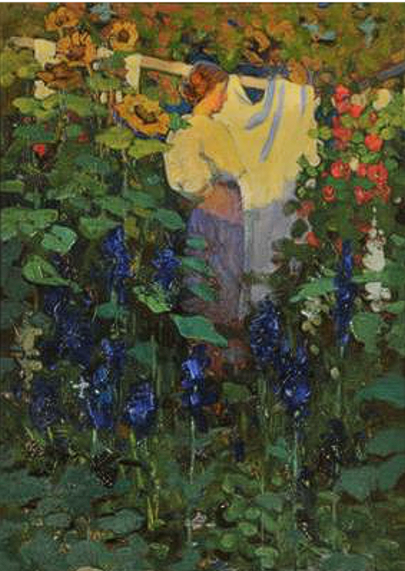

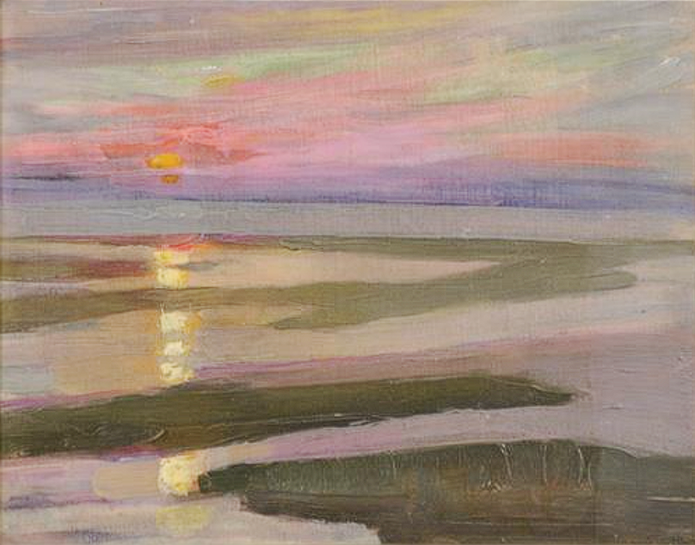
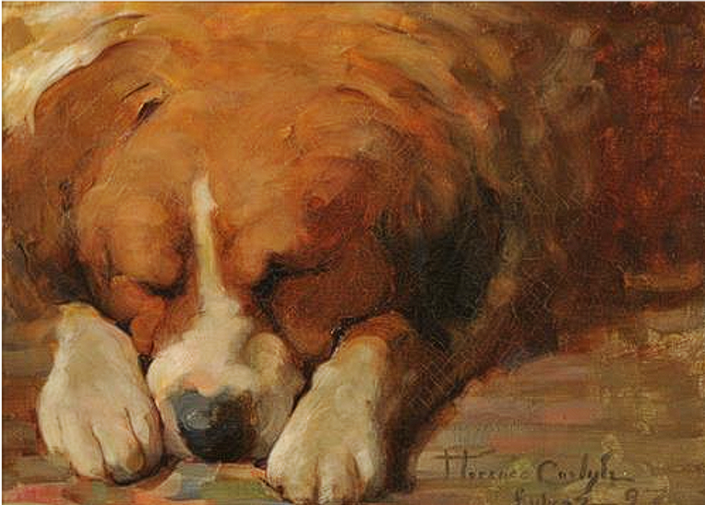
Cape Cod Sunset
St. Bernard
( 1889 )
( 1897 )
Oil on canvas, 22.7 x 28.8 cm
Collection: The Woodstock Art Gallery
Oil on canvas, 28.2 x 39.0 cm
Collection: The Woodstock Art Gallery
The Garden at Englewood
Oil on canvas, 183.8 x134.6 cm
Collection: Art Gallery of Ontario, Toronto (72/14)
( 1907 )
Oil on canvas, 65.8 x 48.4 cm
Collection: The Woodstock Art Gallery

Slide 9
Cape Cod Sunset
( 1889 )
Oil on canvas, 22.7 x 28.8 cm
Collection: The Woodstock Art Gallery
The Garden at Englewood
Oil on canvas, 183.8 x134.6 cm
Collection: Art Gallery of Ontario, Toronto (72/14)
( 1907 )
Oil on canvas, 65.8 x 48.4 cm
Collection: The Woodstock Art Gallery

Slide 10
Oil on canvas, 22.7 x 28.8 cm
Collection: The Woodstock Art Gallery
Oil on canvas, 28.2 x 39.0 cm
Collection: The Woodstock Art Gallery
The Garden at Englewood
( 1907 )
Oil on canvas, 65.8 x 48.4 cm
Collection: The Woodstock Art Gallery

Slide 11
St. Bernard
( 1897 )
Oil on canvas, 28.2 x 39.0 cm
Collection: The Woodstock Art Gallery
The Garden at Englewood
( 1907 )
Oil on canvas, 65.8 x 48.4 cm
Collection: The Woodstock Art Gallery

Slide 12
Cape Cod Sunset
St. Bernard
( 1889 )
( 1897 )
Oil on canvas, 22.7 x 28.8 cm
Collection: The Woodstock Art Gallery
Oil on canvas, 28.2 x 39.0 cm
Collection: The Woodstock Art Gallery
The Garden at Englewood
Oil on canvas, 183.8 x134.6 cm
Collection: Art Gallery of Ontario, Toronto (72/14)
( 1907 )
Oil on canvas, 65.8 x 48.4 cm
Collection: The Woodstock Art Gallery

Slide 13

THE LITTLE ARTIST
THE RISE
TOWARDS THE END
Florence Carlyle was born in Galt, Ontario and lived most of her early life in Woodstock, Ontario. It was during these early years that her aptitude for drawing and colour got recognized. ​Florence’s artistic journey started at home, thanks to her mother, Emily. As a former college principal, Emily wasn't about to let the local village kids miss out on a creative education, so she actually brought in an art teacher from nearby London, Ontario.
Her father, however, had much more traditional ideas. While he happily sent all three of Florence’s brothers off to McGill University, he firmly believed that his daughters only needed enough education to run a household. But Florence wasn’t having it.
​In a 1914 interview, she laughingly admitted that she was so desperate to study art that she started giving painting lessons before she even felt qualified to do so, masking her own doubts to get by. She ended up teaching a class of young women in Woodstock and went on to spend five summers running an art school at Grimsby Park near St. Catharines while she was still a student at Woodstock College herself.
In 1883, where several paintings of hers were displayed at the Toronto Industrial Exhibition ( now known as Canadian National Exhibition ), an artist from London named Paul Peel, admired her work. He encouraged her to pursue formal training and education at art schools, and that led to her getting admitted to Academie Julian in Paris, where she learned more in art from peers and under William Bouguereau, Jules Lefebvre and Tony Robert-Fleury. She participated in three salon shows and, in 1893, exhibited her paintings at the Royal Academy in Paris.
She returned toher native country, Canada in 1896 to take up a teaching post at Havergal College. She had studios in London and Woodstock and, in 1897, became the first woman to be elected an Associate of the Royal Canadian Academy. In 1899, she established a studio in New York and a steady demand for her work grew.
During the early 1900s Carlyle traveled extensively, painting in Holland. Belgium, Spain, Italy. Venice. France. England and New England. In 1903. she won a con- test for the Osborne Company of New York that Norman Rockwell also won -to produce a 12-month calendar.
She returned to Woodstock in 1909 from New York due to her parents' ailing health. As the older sister,she cared for them untilher father passed away in 1911 and then her mother in 1912. She worked out of a small barn located at 146 Wilson Ave.behind her childhood home of "Englewood" during this time.
Florence Carlyle died at her Crowborough home in the spring of 1923 at the age of 59. Florence Carlyle's works can be found in a number of permanent col- lections in Canada, such as the National Gallery of Canada, the War Museum in Ottawa, the Art Gallery of Ontario in Toronto and the Hamilton Art Gallery, as well as Museum London.
In 1913, she moved to England to be with her brother and then Carlyle and a friend, Julie Hastings, moved to Crowborough and pur- chased The Cottage Sweethaws., During the First World War,
With over 50 pieces, the Woodstock Art Gallery has the largest public collection of her work in North America.
Oil on canvas, 28.2 x 39.0 cm
Collection: The Woodstock Art Gallery
DID YOU KNOW?
Some time in Carlyle’s life, she met Judith Hastings, who later became her lifelong companion and model. In 1913, they settled in Yew Tree Cottage in East Sussex. “The Guest, Venice”, shows both of them in conversation at sunset in a scene dominated by warm reds and yellows. The women’s poses and gestures seem toreflect each other - Hastings, seated, invitingly pulls on a long necklace while Carlyle leans comfortably on a windowsill, their complimentary poses suggesting an intimate relationship.

Slide 14
THE RISE
TOWARDS THE END
TO LEARN MORE,
CHECK OUT:
In 1883, where several paintings of hers were displayed at the Toronto Industrial Exhibition ( now known as Canadian National Exhibition ), an artist from London named Paul Peel, admired her work. He encouraged her to pursue formal training and education at art schools, and that led to her getting admitted to Academie Julian in Paris, where she learned more in art from peers and under William Bouguereau, Jules Lefebvre and Tony Robert-Fleury. She participated in three salon shows and, in 1893, exhibited her paintings at the Royal Academy in Paris.
She returned toher native country, Canada in 1896 to take up a teaching post at Havergal College. She had studios in London and Woodstock and, in 1897, became the first woman to be elected an Associate of the Royal Canadian Academy. In 1899, she established a studio in New York and a steady demand for her work grew.
During the early 1900s Carlyle traveled extensively, painting in Holland. Belgium, Spain, Italy. Venice. France. England and New England. In 1903. she won a con- test for the Osborne Company of New York that Norman Rockwell also won -to produce a 12-month calendar.
She returned to Woodstock in 1909 from New York due to her parents' ailing health. As the older sister,she cared for them untilher father passed away in 1911 and then her mother in 1912. She worked out of a small barn located at 146 Wilson Ave.behind her childhood home of "Englewood" during this time.
Florence Carlyle died at her Crowborough home in the spring of 1923 at the age of 59. Florence Carlyle's works can be found in a number of permanent col- lections in Canada, such as the National Gallery of Canada, the War Museum in Ottawa, the Art Gallery of Ontario in Toronto and the Hamilton Art Gallery, as well as Museum London.
In 1913, she moved to England to be with her brother and then Carlyle and a friend, Julie Hastings, moved to Crowborough and pur- chased The Cottage Sweethaws., During the First World War,
With over 50 pieces, the Woodstock Art Gallery has the largest public collection of her work in North America.
https://blockclubchicago.org/2022/10/06/the-first-homosexuals-exhibition-at-wrightwood-659-explores-early-understandings-of-homosexuality-and-its-evolution/OOO
Carlyle: Strong and gutsy by Heather Rivers
Florence Carlyle: Against All Odds by Joan Murray
Florence Carlyle: A Canadian in Paris 1890-1896 by Susan Butlin
Celebrated citizens: Woodstoxk's Most Famous Artist by Keith Maryanovich
https://www.woodstockartgallery.ca/
DID YOU KNOW?
Some time in Carlyle’s life, she met Judith Hastings, who later became her lifelong companion and model. In 1913, they settled in Yew Tree Cottage in East Sussex. “The Guest, Venice”, shows both of them in conversation at sunset in a scene dominated by warm reds and yellows. The women’s poses and gestures seem toreflect each other - Hastings, seated, invitingly pulls on a long necklace while Carlyle leans comfortably on a windowsill, their complimentary poses suggesting an intimate relationship.

