Slide 1
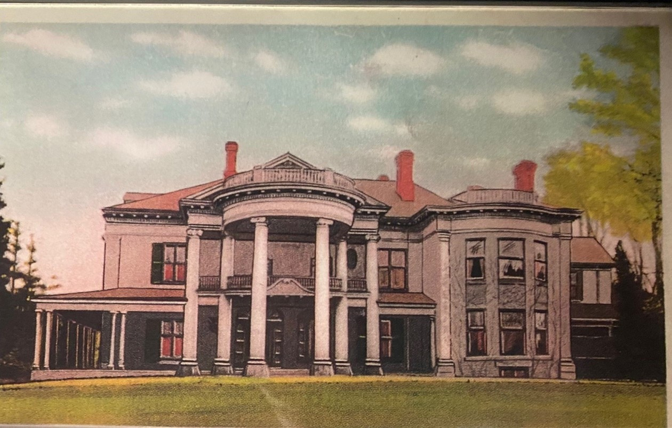
Altadore
A house fit for a king
History
Residence
Famous Visitors
Architecture
More Resources

Slide 2
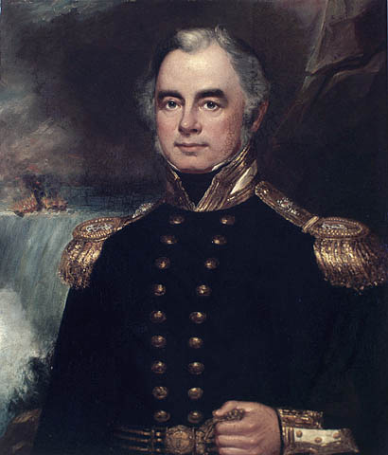
History
When Andrew Drew first came to Woodstock in 1832, he had been asked to purchase land for a house for his friend, Henry Vansittart. He chose what was thought to be a prime location for the residence – the block of land that was situated within the area of Dundas Street, Devonshire Street, Wellington Street North, and Huron Street. However, Admiral Vansittart didn’t like the location, and he never lived there. Instead, he stayed in a local hotel until his new home was built, North of Eastwood.
Credit: Library and Archives Canada / Acc. No. 1990-602-1

Slide 3


Residents
Royal Canadian Legion
Andrew Drew
Dr. T.J. Cottle
James Sutherland
Henry Vansittart
Henry Finkle
Henry Little

Slide 4
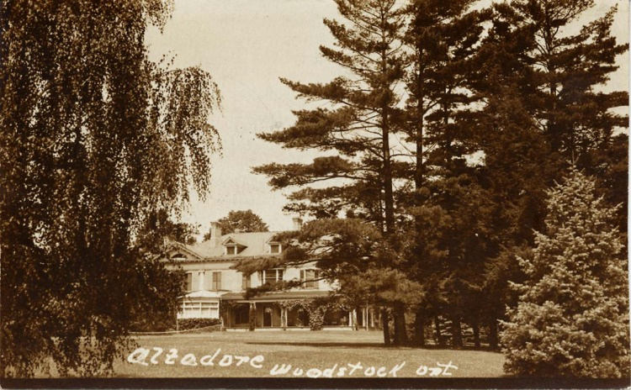
Residents
Dr. Thomas John Cottle
In 1837 the property in Woodstock was sold to Peter deBlacquiere, soon to be the new Warden of the entire district. Then, when this gentleman was chosen to be the first Chancellor of the University of Toronto, the property was sold to Dr. T.J. Cottle, who had come to Upper Canada from the British West Indies.
The first house he had built on the property was a fairly small wooden frame house which was called “Altadore”, which means “round hill” in West Indian. Unfortunately, this one-storey house had a fire and in 1858, was soon replaced by a large English manor house.
While Dr. Cottle lived in the house, he hosted a very important guest.
In 1871, after Dr. Cottle passed away, the Canadian Bank of Commerce purchased the property, so that future bank managers could live in this magnificent residence.

Slide 5
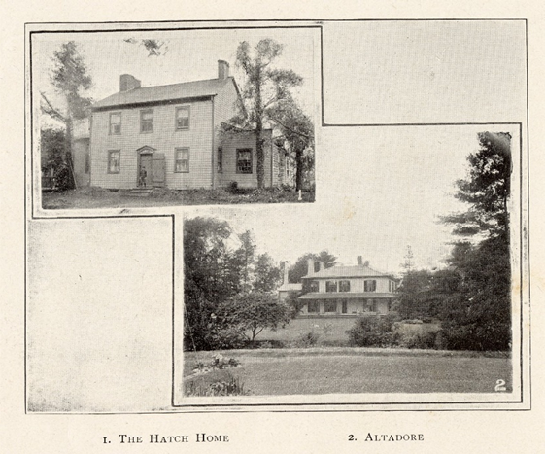
Residents
Henry Finkle and James Sutherland
Henry Finkle purchased Altadore in 1901 but almost immediately sold it to the Honourable James Sutherland, the MP for North Oxford, who was also the federal Minister for Public Works. He has the house redecorated and even added a large 16.8 meters by 6 meters two-storey wing on the west side of the house. At the front of the house, a porte-cochere with tall white Ionic columns was established, and then at the other side of the house a new ‘wing’ to house the kitchen was built. Next, a large verandah was built on the east, north and west sides, with a conservatory at the back of the house.
In addition, a large red brick stable was constructed, along with a gatehouse for the coachman and another gatehouse was built at the south end of the property for the gardener.

Slide 6
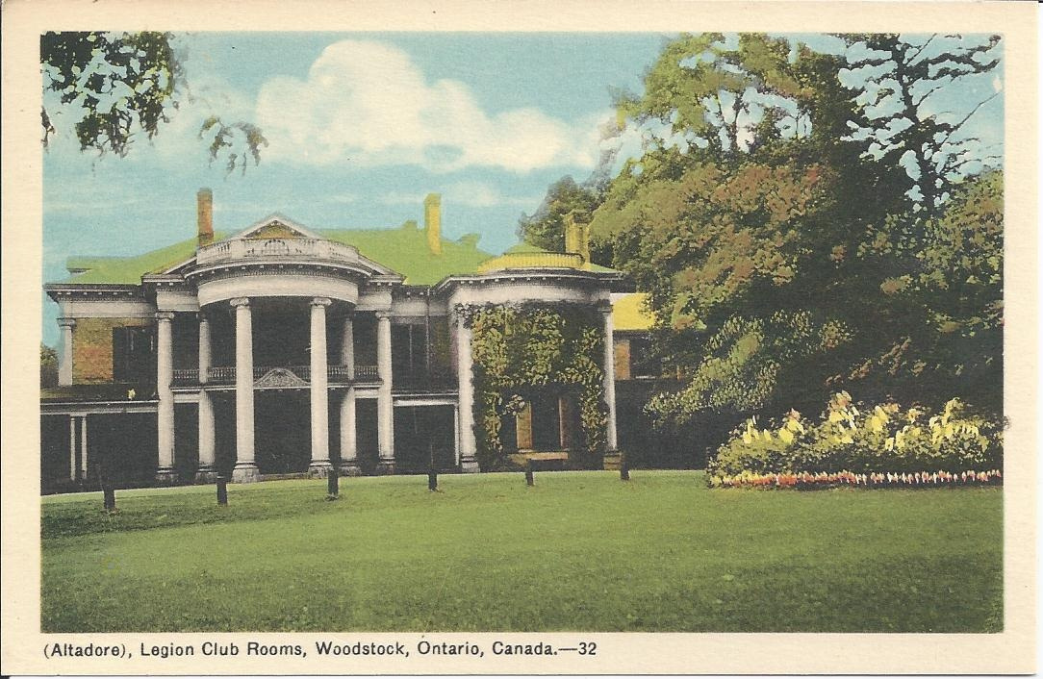
Residents
Henry Little and the Royal Canadian Legion
After the death of James Sutherland, Altadore was inherited by his nephew, Henry Little who lived in this grand house until he too, passed away. His widow continued to live in Altadore until she sold it to Branch 55, Royal Canadian Legion in 1946.
The old stable soon became the Legion’s canteen until 1956 when a large Memorial Hall was constructed. 11 acres of the property was sold to the Woodstock Board of Education to build Northdale Public School. The original one-storey school was built in 1950. Altadore was almost 100 years old when it was demolished in 1957. However, the two gatehouses were turned into residences, and the memories of this beautiful building remain.

Slide 7
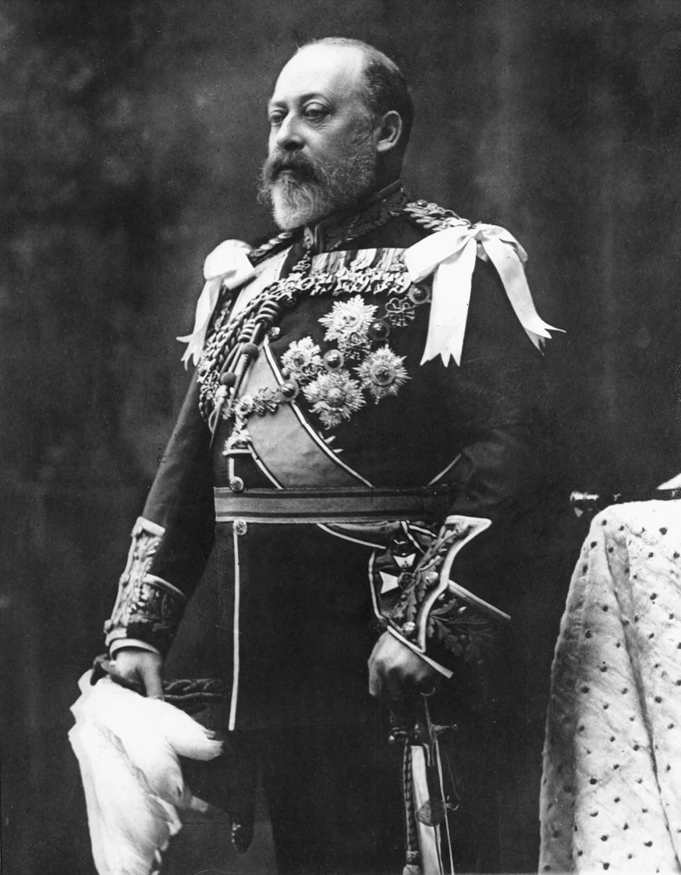
Famous Visitor
One such visit took place in 1860 when Edward, the Prince of Wales (later King Edward VII) arrived at the Great Western Railway station in Woodstock. He was received by local dignitaries including Mayor Thomas Cottle. The Woodstock Volunteer Rifle Company, and bands from Tillsonburg, Norwich, and Woodstock were also waiting at the train station. The Prince of Wales would spend the night at Altadore and attend a social event with the local elite.
The manor house Altadore was owned by Mayor Cottle at the time, Altadore Crescent is named after the house which stood in the area historically. During his time in Woodstock, the Prince of Wales’s carriage became stuck in mud on his way to visit Senator Alexander. Allegedly, the prince helped push the carriage out of the mud. The Prince of Wales was crowned King in 1901 and reigned until 1910.

Slide 8
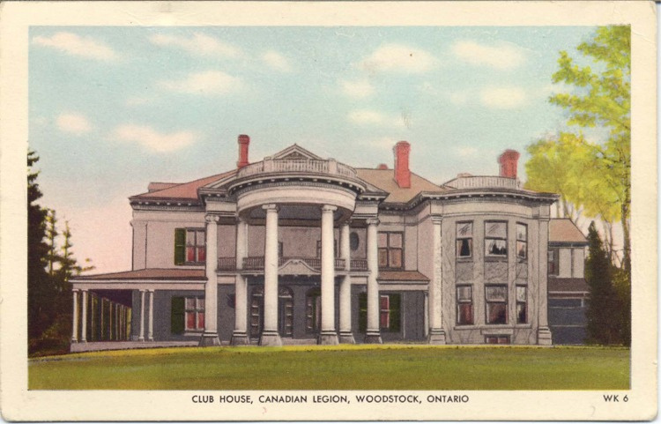
Architecture
James Sutherland added the large 16.8 x 6 meters two-storey wing on the west side of the house, in addition to the Porte-cochere, and a new wing for a kitchen.
Porte-cochere: A large porch that projects over a driveway at the entrance to a house or building. It allows family and guest to enter/exit a vehicle without getting wet or cold in rainy or snowy weather.
The estate was surrounded by a wrought iron fence, well-kept lawns, trees and beautiful gardens. It is rumoured that the pit from a peach that Prince Edward, (later King George VI) ate was planted and eventually supplied a number of trees in the city.
Ionic Pillars: first built in the easter part of Greece, better known as Iona. The high column of the pillar is marked with long indents, going all the way around. Then, at the top, or capital, there are carvings that look like a scroll being unwound, along with other fancy details.
Altadore was famous far and wide for its beautiful and intricate handcrafted woodwork in oak, walnut, and cherry wood.
James Sutherland also added the large veranda that ran along the east, north, and west sides of the home. A conservatory was built on to the back of the home too.
James Sutherland remodelled the house and added two lodges and stables. He also landscaped the grounds.
The Coachman’s and Gardener’s homes still remain after the mansion was torn down.

Slide 9
More Resources

